Slide 1



Goals ◾ Increase citizen engagement at the Long-Term Ecological Research site on Niwot Ridge ◾ Build up a geographic and photographic dataset of plant species Why To record how species’ geographic distributions and phenology (timing of flowering) are shifting with climatic changes. How Create a mobile application and corresponding website to allow visitors to search for and add observations of plant species in the Niwot Ridge area . The app allows users to view and filter a field guide, helping them to identify plants they encounter. The user can then take a photo observation and sync it to the website where researchers can verify the sighting. The sighting is added to a map, so researchers and plant enthusiasts can explore the location and phenology of plants of interest.
Challenges Faced
Goals
Risk | Mitigation Strategy/Outcome
Previous Code | Use code when it makes sense
Real CSV | Use dummy CSV until real one is obtained
Platform Diversity | Worked towards same mock-up
CU Server | Used a different server
Database | Used Google Firebase
Field Guide Photos | Used a single photo until given photos
Sponsor Availability | Communicate via slack and video conferences often and regularly
An Adventure Awaits!
Why
Developed by
How
Ryan O’Connell, Chase Springer, Brian Larson, D’Vreaux Fontaine, Jennifer Baumann, Kevin Rau
Process
Acknowledgments
Luminous Moss Boses (2014-15 CS project team)
Environmental Studies Program at the University of Colorado, Boulder
Institute of Arctic and Alpine Research
National Science Foundation (Long Term Research in Environmental Biology grant to DF Doak and WF Morris; Long Term Ecological Research program at Niwot Ridge)
Trevor DiMartino, our loving advisor
Requirements
Mock-Ups
Database Development
Field Guide
Observations
Distribution Maps
Sponsors
DEPLOY
Nathalie Chardon, Jane Smith

Slide 2
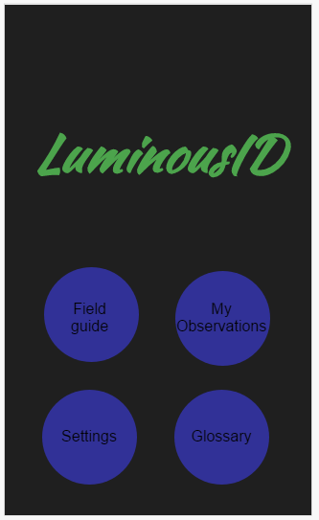
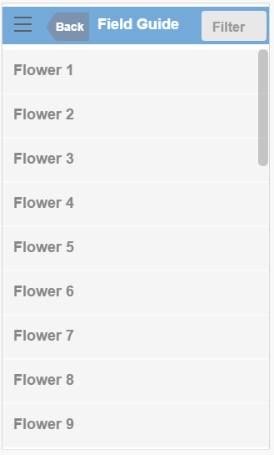
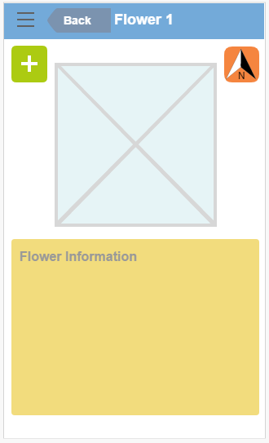
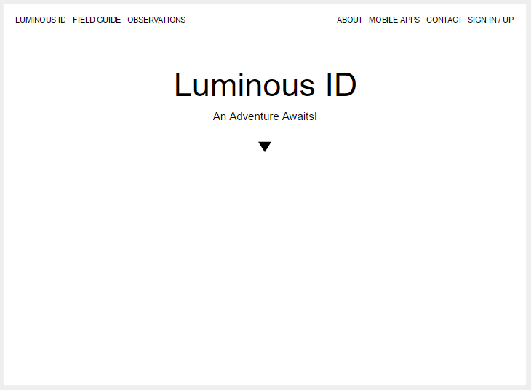
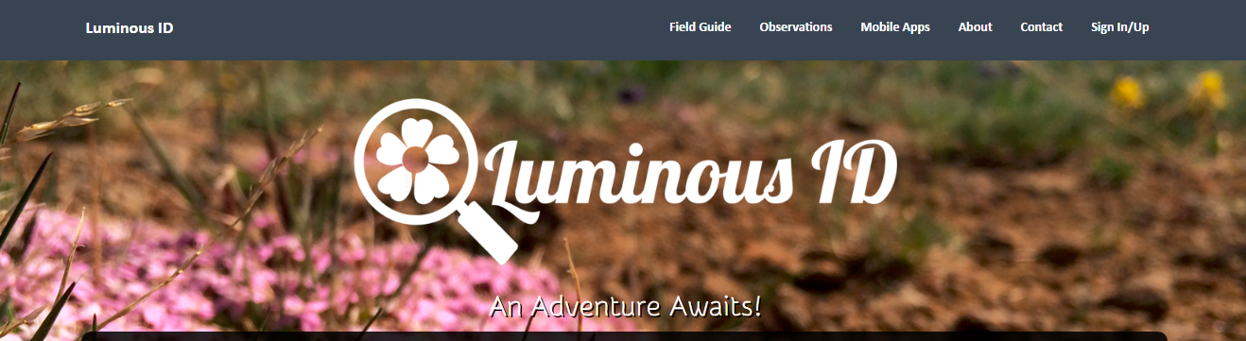
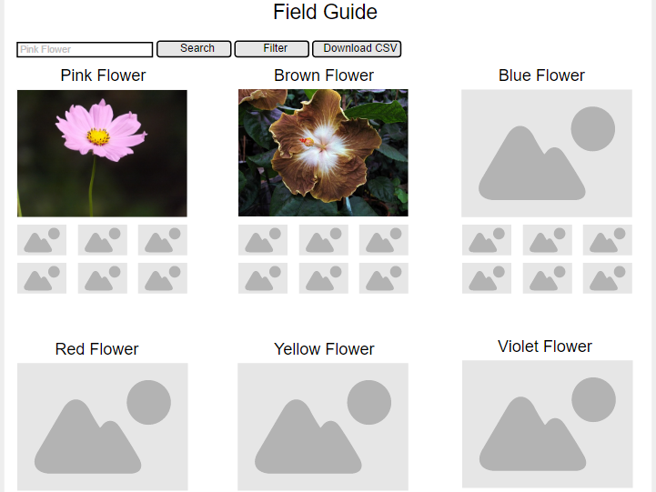
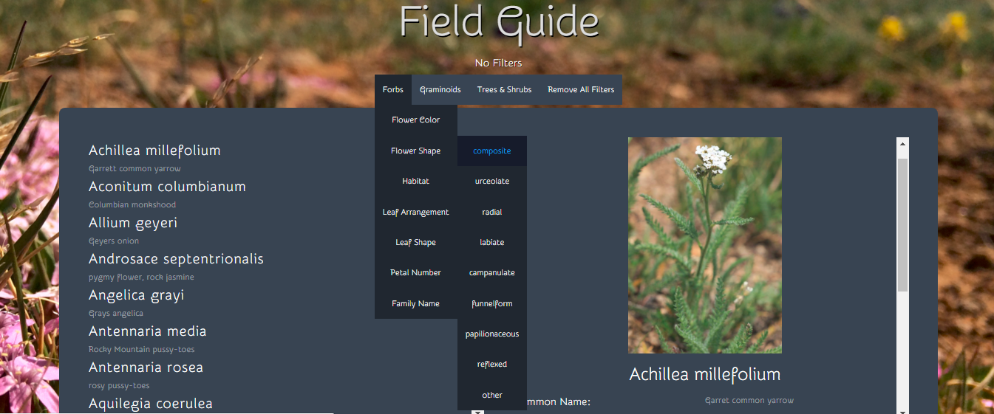
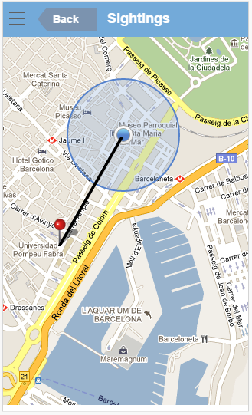
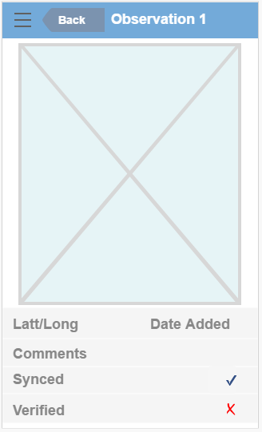
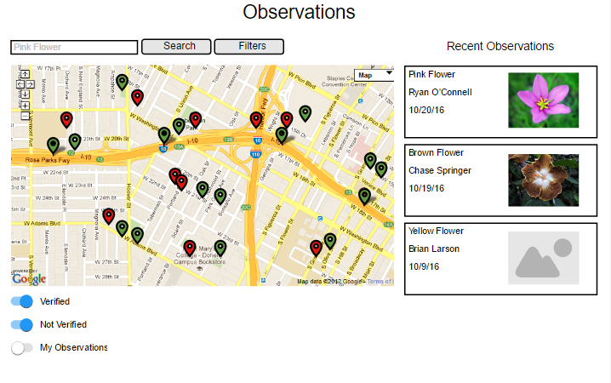
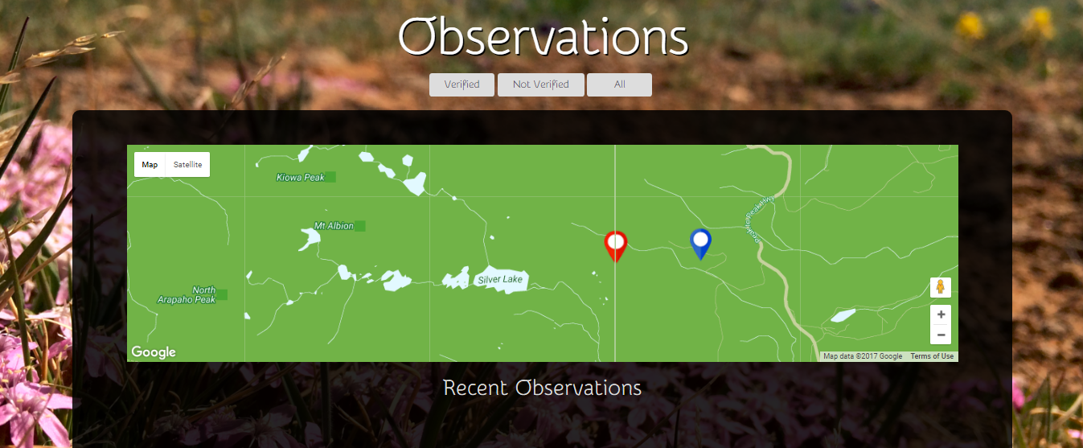
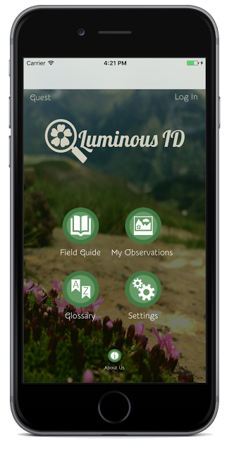
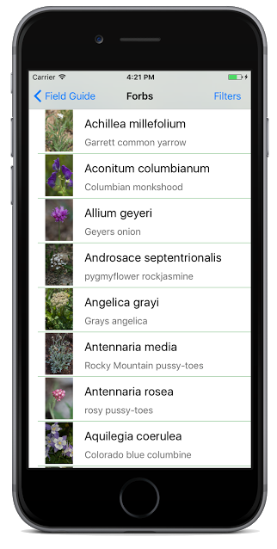
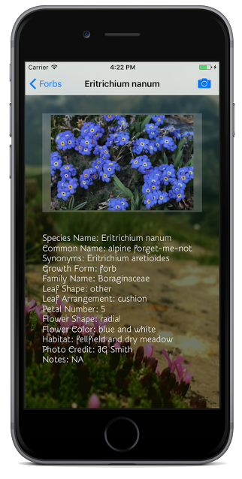

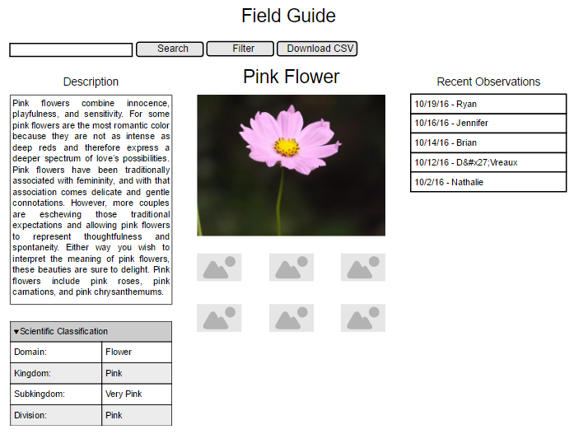
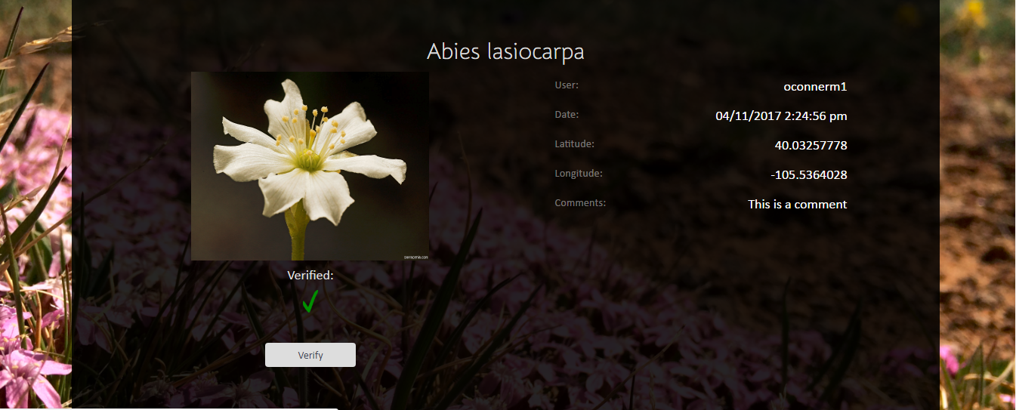
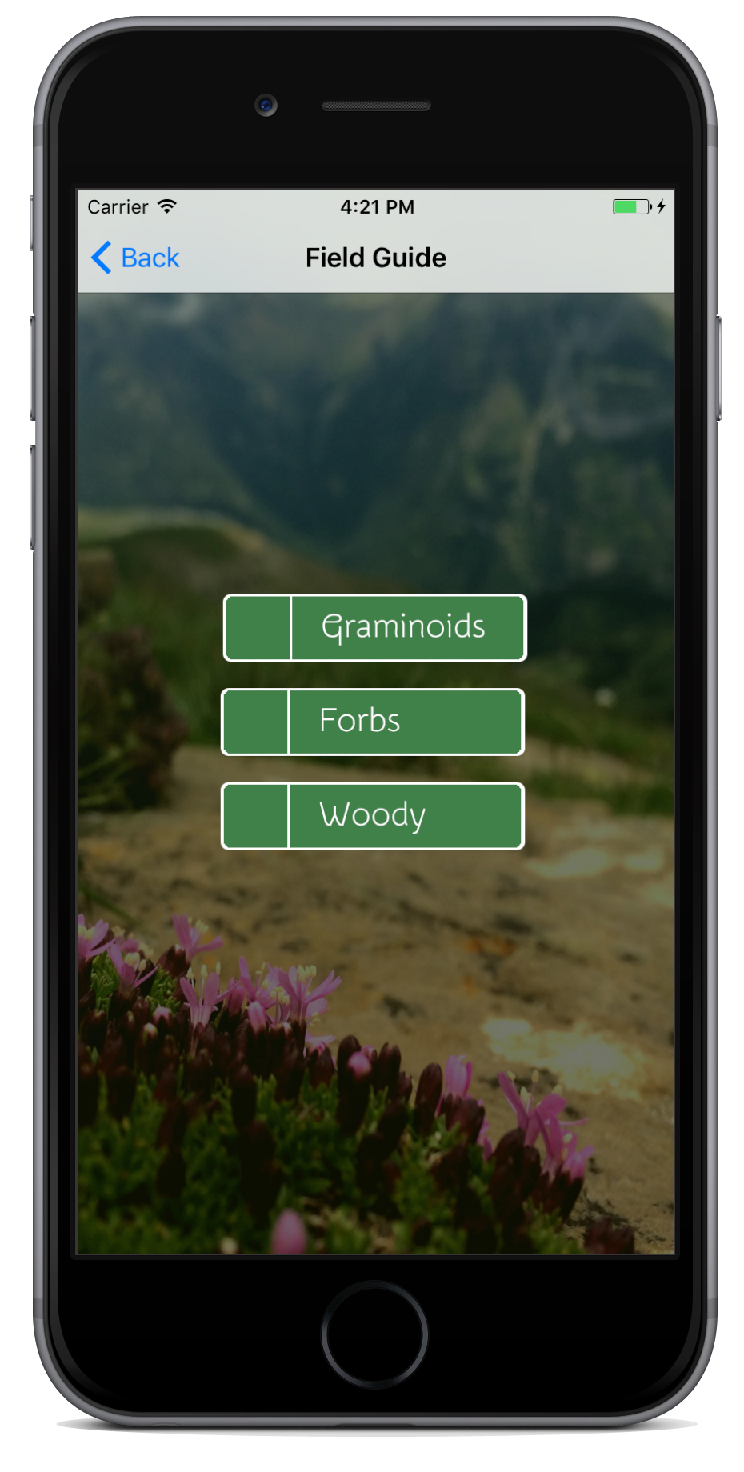
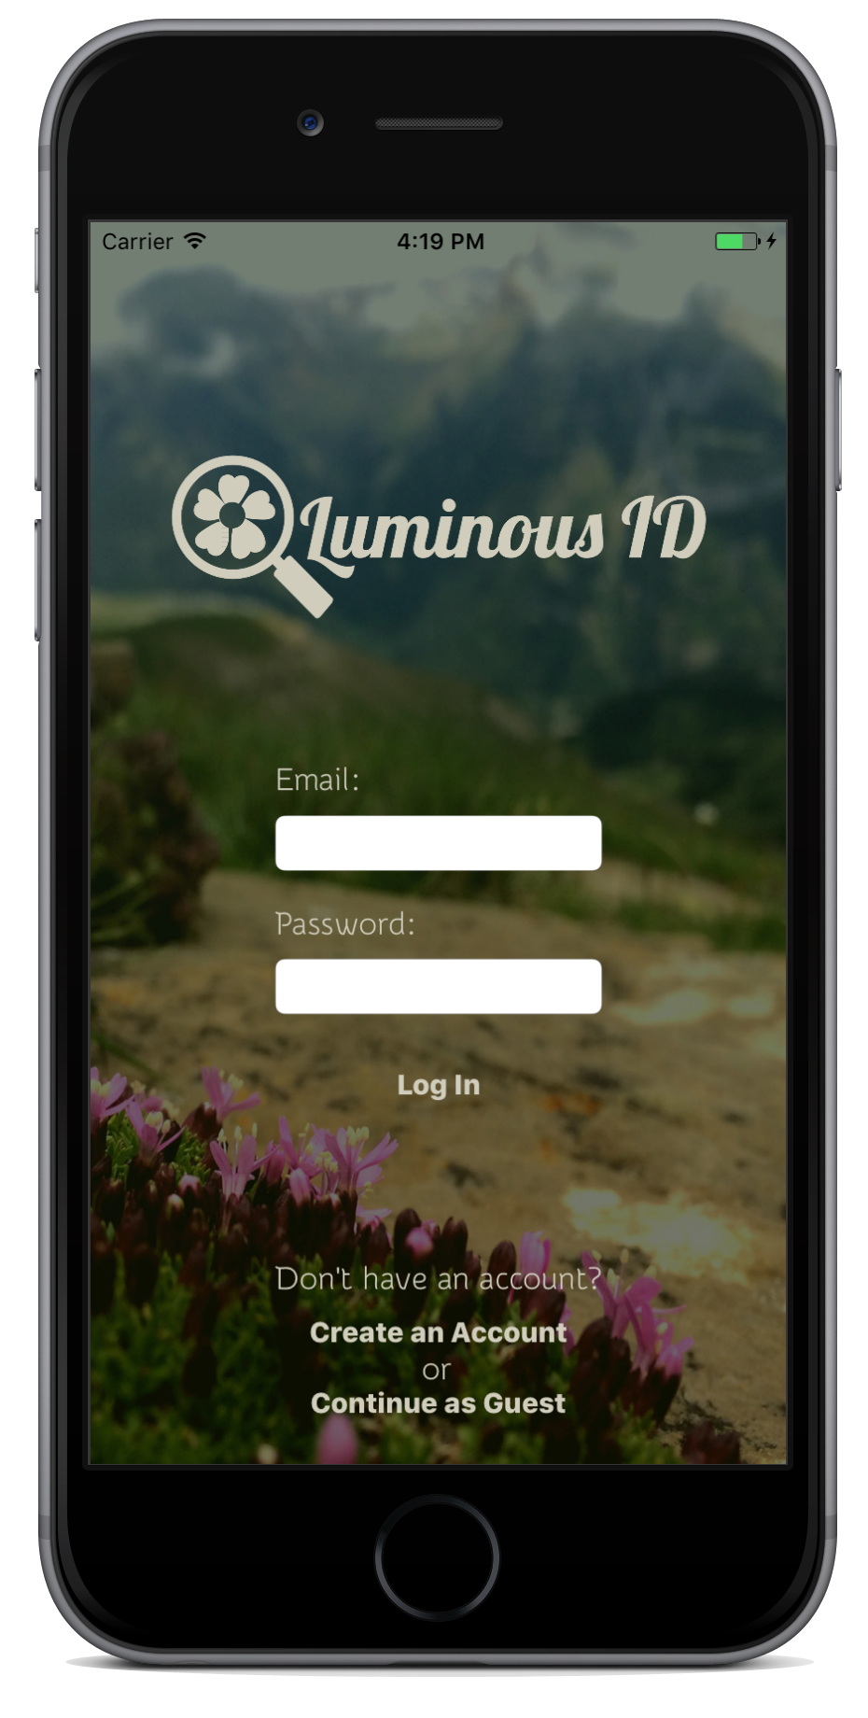

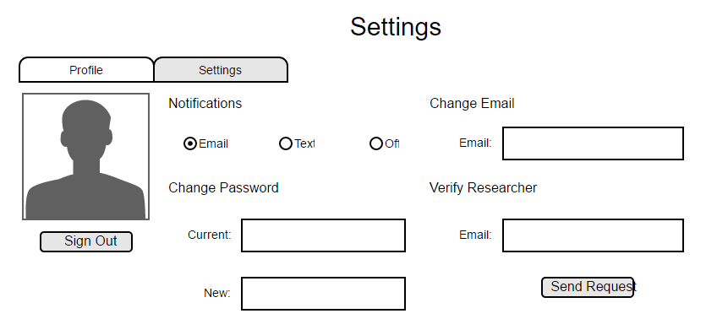
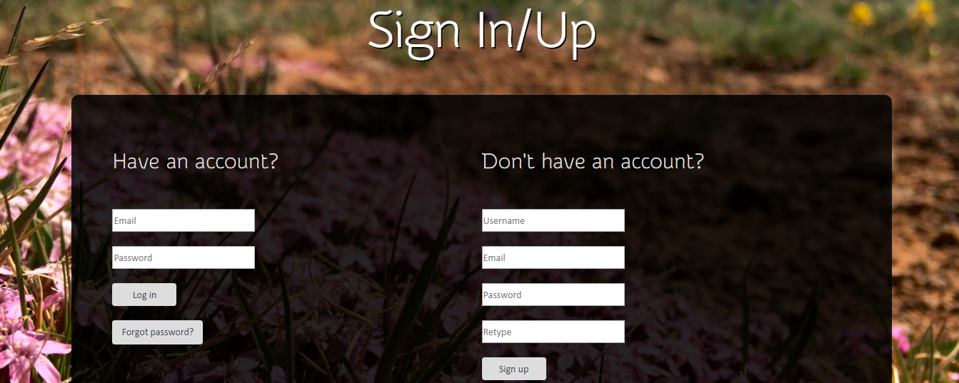
Website Development
Mobile Applications
Database Development
The development of the database was the largest roadblock to overcome. After creating the schemas we then had to find a backend tool to help build the database. Finding the right tool was a multistep process that involved researching, exploring, and starting over. We ended up using Firebase, a backend created by Google, for both our website server and database creator.
Mock-up
Website
Mock-Up
Homescreen
Field Guide
Observations Map
Mobile Application
 | Pros: Central database was easy and quick to create. PHP code was auto-generated.
 | Cons: Local database for mobile apps had to be hand coded.
 | Pros: Communicates with mobile apps easily. Easy account manager. Provides server for website.
 | Cons: Not scalable for large amounts of users.
Observation Information
Sign-in/Sign-up
After finding Firebase we created the website on Firebase’s hosting platform. Getting the iframe to update dynamically based on user updates was difficult. Making the the website mobile friendly was too ambitious to finish in time.
We faced several challenges when creating the apps. To make the apps as similar as possible for iOS and Android, we developed toward a single mock-up. Both apps are developed using very different languages, and making the apps have a similar feel proved difficult.

